Slide 1
Photon Unity Networking (PUN)
Concordia University | COMP 476 - Lab
Lab Slides created by Daniel Rinaldi

Slide 2
PUN
Concordia University | COMP 476 - Lab
Lab Slides created by Daniel Rinaldi
Photon is a real-time multiplayer game development framework that is fast, lean and flexible. Photon consists of a server and multiple client SDKs for major platforms.
Photon Unity Network (PUN) is a Unity specific, high-level solution: Matchmaking, easy to use callbacks, components to synchronize GameObjects, Remote Procedure Calls (RPCs) and similar features provide a great start. Beyond that is a solid, extensive API for more advanced control.
There is an Online Documentation, which is considered a manual for PUN. This might become your primary source for information.
It summarizes the most important classes in the Public API module and explains each class, method and field individually. This is generated from the source of PUN and should be used to look up details on usage and parameters.
Before you get started with Photon, make sure to create a free Photon account here : https://id.photonengine.com/en-US/Account/SignUp

Slide 3
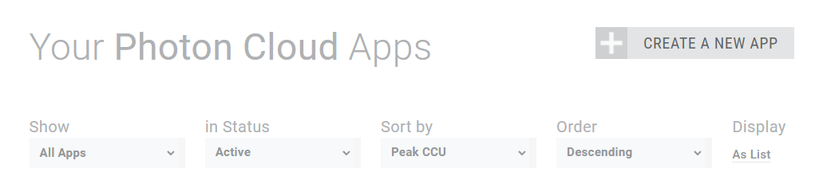
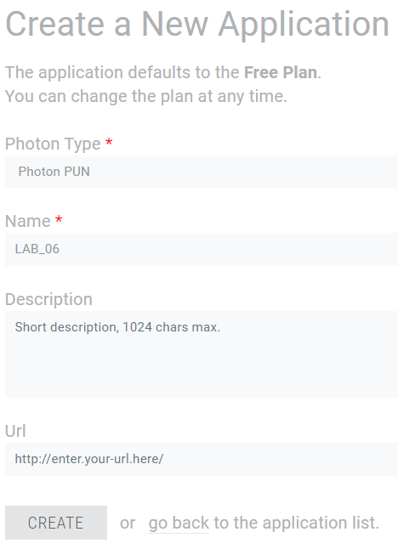
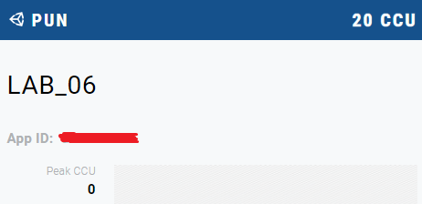
PUN: Photon App Setup
Concordia University | COMP 476 - Lab
Lab Slides created by Daniel Rinaldi
1
After registering and signing in, head to your Photon dashboard to setup a new Photon app: https://dashboard.photonengine.com/en-US/
After creating a new app, take note of your App ID as you will use it later in the Unity editor. You need to create an App for each networked game you create.
2
3
4

Slide 4
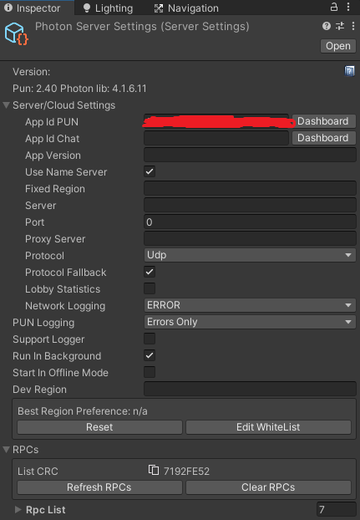
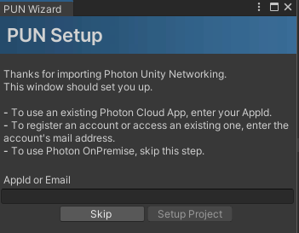
PUN: Unity Setup
Concordia University | COMP 476 - Lab
Lab Slides created by Daniel Rinaldi
After creating a new project in Unity, go to the Unity asset store and get the free PUN 2 package which can support a maximum of 20 players: https://assetstore.unity.com/packages/tools/network/pun-2-free-119922
In Unity, go to Window > Package Manager. In the Package Manager Window, select My Assets under the packages dropdown and you should see “PUN 2 - FREE” in the list of packages. Select it and in the bottom right corner of the window press the “download” button and then press import. This should import all the required packages and group them under a folder called “Photon” in the root of your Assets folder.
Once imported, the Photon Project Setup Wizard
should appear. Enter your App ID that you made a
note of earlier in the text field and press “Setup
Project”. This should create and setup a Photon
Server Settings object that will contain various
settings about your PUN application.
Check the documentation for more info on Photon Server Settings:
https://doc.photonengine.com/en-us/pun/v2/getting-started/initial-setup

Slide 5
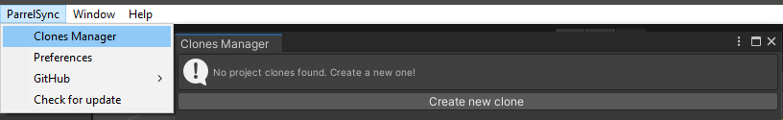
ParrelSync
Concordia University | COMP 476 - Lab
Lab Slides created by Daniel Rinaldi
ParrelSync is a Unity package that is useful for testing multiplayer features in your project. You can download the source code via the github repo here: https://github.com/VeriorPies/ParrelSync
You can also download the latest .unitypackage file from here : https://github.com/VeriorPies/ParrelSync/releases
Then you just need to drag and drop the .unitypackage file into the UnityEditor and it should prompt you for the import.
After importing ParrelSync into the project, you can now open the clones manager window and create and then open the cloned project.
This will clone the entire project and keep the synced project synced up with the current one. Why do we do this? Because the alternative is to make a new build of your game each time you make changes to the code. This is a very lengthy procedure that wastes a lot of time.

Slide 6
Connection And Callbacks
Concordia University | COMP 476 - Lab
Lab Slides created by Daniel Rinaldi
In order to connect to photon servers using the PhotonServerSettings asset, you should call the ConnectUsingSettings() function.
When you load a scene, Unity usually destroys all GameObjects in the current scene before loading the new one. This includes networked objects (we will discuss these soon), which can lead to issues on the network. To avoid network issues with loading scenes, you can set PhotonNetwork.AutomaticallySyncScene to true and use PhotonNetwork.LoadLevel() to sync and load a scene across all clients in a room.
PUN uses callbacks to let you know when the client established the connection, joined a room, etc…
For convenience, PUN has the MonoBehaviourPunCallbacks class which inherits from MonoBehaviour. It implements all the important callback interfaces and registers itself automatically, so you can inherit it and just override specific callback methods.
Alternatively you can implement the interface IConnectionCallbacks in any class and then register instances for callbacks via the static method PhotonNetwork.AddCallbackTarget().
void ConnectToPhotonExample() {
PhotonNetwork.AutomaticallySyncScene = true // sync the current scene across all clients in the same room
PhotonNetwork.ConnectUsingSettings();
}
public class YourClass : MonoBehaviourPunCallbacks {
public override void OnConnectedToMaster() {
Debug.Log("OnConnectedToMaster() was called by PUN.");
PhotonNetwork.JoinRandomRoom();
}
}

Slide 7
Matchmaking
Concordia University | COMP 476 - Lab
Lab Slides created by Daniel Rinaldi
The OnConnectedToMaster() callback will be invoked when the client is connected to the Master Server and ready for matchmaking and other tasks. At this point, you could try to join an existing game session or create your own. The following code snippets show possible method calls to start or join game sessions (Rooms).
When friends want to play together and have a way to communicate outside of PUN (e.g. with Discord), they can make up a room name and enter it in the game. Then the code can invoke JoinOrCreateRoom(roomName, roomOptions, lobby). If nobody else should be matched into this room, you can also make it invisible for matchmaking.
With JoinOrCreateRoom(...), the room gets
created on demand, so it doesn't matter who is
first. If it's full,
IMatchmakingCallbacks.OnJoinRoomFailed()
gets invoked. For more info: MatchMaking Guide
// Join room "someRoom"
PhotonNetwork.JoinRoom("someRoom");
// Fails if "someRoom" does not exist, closed or full. Error callback: IMatchmakingCallbacks.OnJoinRoomFailed
// Tries to join any random room:
PhotonNetwork.JoinRandomRoom();
// Fails if there are no open rooms. Error callback: IMatchmakingCallbacks.OnJoinRandomFailed
// Create this room.
PhotonNetwork.CreateRoom("MyMatch");
// Fails if "MyMatch" room already exists and calls: IMatchmakingCallbacks.OnCreateRoomFailed
RoomOptions roomOptions = new RoomOptions();
roomOptions.IsVisible = false; // make this room invisible for matchmaking
roomOptions.MaxPlayers = 4;
PhotonNetwork.JoinOrCreateRoom(roomName, roomOptions, TypedLobby.Default);

Slide 8
Networked Instantiate
Concordia University | COMP 476 - Lab
Lab Slides created by Daniel Rinaldi
To create networked GameObjects, use PhotonNetwork.Instantiate() instead of Unity’s Object.Instantiate. Any client in a room can call this to create objects which it will control.
PhotonNetwork.Instantiate("MyPrefabName", new Vector3(0, 0, 0), Quaternion.identity);
The prefab must have exactly 1 PhotonView component attached. This component stores and manages a ViewID (the identifier for network messages), who owns the object, etc. (This will be explained in a following slide).
By default, PUN instantiate uses a DefaultPool implementation, which loads prefabs from "Resources" folders and Destroys the GameObject later on.
By default, GameObjects created with PhotonNetwork.Instantiate exist as long as the creator is in the room. When you swap rooms, objects don't carry over, just like when you switch a scene in Unity.
When a client leaves a room, the remaining players will destroy the GameObjects created by the leaving player. If this doesn't fit your game logic, you can disable this: Set the RoomOptions.CleanupCacheOnLeave to false, when you create a room.
The Master Client can create GameObjects that have the lifetime of the room by using PhotonNetwork.InstantiateRoomObject(). Note: The object is not associated with the Master Client but the room instead. By default, the Master Client controls these objects but you can pass on control with photonView.TransferOwnership().

Slide 9
Networked Destroy
Concordia University | COMP 476 - Lab
Lab Slides created by Daniel Rinaldi
You can also manually and explicitly destroy networked objects, using PhotonNetwork.Destroy().
As previously mentioned, when you leave a room the networked GameObjects get destroyed automatically. However, if you are connected and joined to a room and you want to destroy a networked GameObject that was created using PhotonNetwork.Instantiate(...), you should use PhotonNetwork.Destroy(...). This will handle some cleanup tasks and destroy the gameobject across the network.
In order for PhotonNetwork.Destroy(...) to succeed, the GameObject to be destroyed must meet the following conditions:
The GameObject was instantiated at runtime using PhotonNetwork.Instantiate() method call.
If the client is joined to an online room, the GameObject's PhotonView must be owned or controlled by the same client.
Note: GameObjects can be destroyed locally using PhotonNetwork.Destroy(...) without issues if the client is not joined to a room or joined in offline mode (more on this at the end).
For more on Instantiation in PUN, see https://doc.photonengine.com/en-us/pun/current/gameplay/instantiation

Slide 10
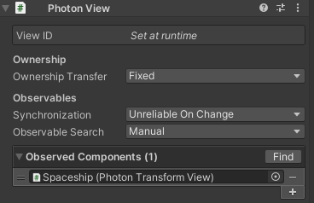
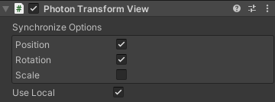
Networked GameObject
Concordia University | COMP 476 - Lab
Lab Slides created by Daniel Rinaldi
As previously mentioned, GameObjects can be instantiated as "networked GameObjects" by attaching a PhotonView component. It identifies the object and the owner across the network using a viewID and also manages which scripts will read and write object state updates (Observed Components) and how those updates are sent. The photon player who's in control, is the one that will update everyone of changes to this object’s state.
Ownership Transfer: Defines if ownership of this PhotonView is fixed, can be requested or simply taken. Note that you can't edit this value at runtime. The current owner has to implement IPunCallbacks.OnOwnershipRequest to react to the ownership request.
Synchonization:
Off: Synchronization does not occur, nothing is sent or received
Reliable Delta Compressed: Data is guaranteed to be received with an internal
optimization mechanism which sends null if data doesn't change. For this to work,
make sure you populate the stream with distinct SendNext calls.
Unreliable: Data is received in order but some updates may be lost. This means no
delay in cases of loss.
Unreliable OnChange: Data is received in order but some updates may be lost.
If updates repeat the last information, the PhotonView will pause sending updates
until the next change.
Observed Components: This is simply a list of components need some data (state) to be
observed and synchronized. These components must inherit from the IPunObservable
interface. Photon provides some components that automatically observe and sync some
common data (ex: PhotonTransformView).

Slide 11
Networked GameObject State Synchronization
Concordia University | COMP 476 - Lab
Lab Slides created by Daniel Rinaldi
Typically, you would add a PhotonView component to a prefab and use PhotonNetwork.Instantiate() to create an networked instance of that object. The prefab that you wish to instantiate must be located within a folder called “Resources” as per the default implementation of the Photon PrefabPool. Recall that Unity discourages and advises against using the Resources folder. Luckily for us there is a way around this which involves implementing the IPunPrefabPool interface. This will be shown in a later slide.
As mentioned in the previous slide, the PhotonView manages a list of observed components. While there are a few scripts that come with Photon that allow you to sync common data without writing any code, there will be cases where you need to sync other data in which there is no built-in component that does it for you. A custom observed component is in charge of writing and reading the state of the networked object several times a second. To do so, a script must implement the IPunObservable interface, which defines the OnPhotonSerializeView(PhotonStream stream, PhotonMessageInfo info) method and implements how the data will be serialized into binary and back (written and read). You must also add this component to the photonView’s list of observed components as well.
// used as Observed component in a PhotonView, this only reads/writes the position
public void OnPhotonSerializeView(PhotonStream stream, PhotonMessageInfo info) {
if (stream.IsWriting) // write properties to stream
{
Vector3 pos = transform.localPosition;
stream.SendNext(pos);
}
else // read properties from stream
{
Vector3 pos = (Vector3) stream.ReceiveNext();
}
}
This way of synchronizing state is useful and should be used for data that gets updated very frequently.
Normally, if all you need to do is sync the Transform component data then you just need to add a PhotonTransformView component to the gameobject and drag it into the observed components list of the PhotonView component.
Serialization and Deserialization must be done in the same order.
Notes:
Data synced in this way is sent over an unreliable channel (there can be packet loss). This is rarely noticeable for data requiring continuous change.

Slide 12
Remote Procedure Calls
Concordia University | COMP 476 - Lab
Lab Slides created by Daniel Rinaldi
Clients can also perform Remote Procedure Calls (RPC) on specific networked objects for anything that happens infrequently:
RPC Targets, Buffering And Order
You can define which clients execute an RPC. Most of the time we just send the event to everyone using RPCTarget.All.
MasterClient : Sends the RPC to the master client (host) only.
Others values [Others, OthersBuffered] : Sends the RPC to everyone else. The sending client does not execute the RPC.
Buffered values [AllBuffered, AllBufferedViaServer, OthersBuffered] : The server will remember your RPCs and when a new player joins, it gets the RPC event even though it happened earlier (unless the sending client leaves). Use this with care, as a long buffer list causes longer join times.
ViaServer values [AllViaServer, AllBufferedViaServer] : Usually, when the sending client has to execute an RPC, it does so immediately, then sends it to all other clients. This, however, affects the order of events, because there is no lag when calling a method locally. This is especially interesting when RPCs should be done in order. RPCs sent via the server are executed in the same order by all receiving clients. It is the order of arrival on the server.
Alternatively, you can call an RPC for a specific player in the room. Use the overloaded function with the target Player as second parameter. If you directly target the local player then this will be executed locally and won't go through the server.
// defining a method that can be called by other clients:
[PunRPC]
public void ExampleMethodRPC(int[] exampleArray)
{
Debug.LogFormat("RPC call ‘ExampleMethodRPC’ : {0}", myParameter);
}
// calling the RPC somewhere else in your code
photonView.RPC("ExampleMethodRPC", RpcTarget.All, (object) someIntArray);
Notes:
Example rpc call: a client needs to use a key from their inventory to unlock a door for the other party members.

Slide 13
Remote Procedure Calls
Concordia University | COMP 476 - Lab
Lab Slides created by Daniel Rinaldi
RPC Considerations
By design, the script that has the RPC methods needs to be attached to the exact same GameObject as the PhotonView not its parent nor its child.
The RPC method cannot be static.
Generic methods are not supported as PUN RPCs.
An RPC method that has a return value other than void can be called but the return value will not be used. Unless you need the return value in other explicit direct calls to the same method, always use void as a return value.
If the RPC method is overridden, do not forget to add the [PunRPC] attribute to it. Otherwise, inherited methods not overridden that have [PunRPC] attribute on the base class can be used.
Do not attach more than one component of the same type and that have RPC methods on the same GameObject as a PhotonView. If you have a class called MyClass that implements a method MyRPC marked as PunRPC, you should not attach more than one instance of it to the same GameObject. You can even make use of Unity’s [DisallowMultipleComponent] class attribute.
Make sure that you use a unique name per RPC method. Do not create overloaded RPC methods.
It is not recommended to use optional parameters in RPC methods. If necessary, pass all parameters including optional ones during the RPC call. Otherwise, the receiving clients will not be able to find and process the incoming RPC.
Not all data types are automatically serializable by Photon. Try to use simple types like Vector3, int, float, bool, string. For a full list of supported data types visit: https://doc.photonengine.com/en-us/realtime/current/reference/serialization-in-photon
If you want to send an object array as a parameter of an RPC method, you need to cast it to object type first.

Slide 14
Properties Synchronization
Concordia University | COMP 476 - Lab
Lab Slides created by Daniel Rinaldi
Typically, rooms and players may have some attributes that are not related to a GameObject. Examples: the current map or the color of a player's character. These can be sent via Object Synchronization or RPC, but it is often more convenient to use Custom Properties.
To set Custom Properties for a Player, use Player.SetCustomProperties(Hashtable propsToSet) and include the key-values to add or update. A shortcut to the local Player object of the current client is: PhotonNetwork.LocalPlayer. Similarly, you can use PhotonNetwork.CurrentRoom.SetCustomProperties(Hashtable propsToSet) to update the custom properties of the room you are in. All updates take a moment to distribute but all clients will update their room and player CustomProperties accordingly.
When CustomProperties are changed, Photon will invoke the following callbacks:
IInRoomCallbacks.OnRoomPropertiesUpdate(Hashtable propertiesThatChanged)
IInRoomCallbacks.OnPlayerPropertiesUpdate(Player targetPlayer, Hashtable changedProps)
Note that the HashTable type is just a custom type provided by the Photon API which just inherits from Dictionary<object, object>. It is found in the ExitGames.Photon.Client namespace.

Slide 15
Custom Events
Concordia University | COMP 476 - Lab
Lab Slides created by Daniel Rinaldi
Independent from GameObjects, you can raise your own events and send them without any relation to some networked object:
Events are described by using an unique identifier, the eventCode. In Photon this event code is described as a byte value, which allows up to 256 different events. However some of them are already used by Photon itself, so you can't use all of them for custom events. After excluding all of the built-in events, you still have the possibility to use up to 200 custom event codes [0..199]. The event code 0 should be avoided if you are going to use advanced events cache manipulation (see link below).
The eventContent can be anything that PUN can serialize (see the bottom of the previous slide for more info on what data types Photon can serialize).
The third parameter describes the RaiseEventOptions. With these options, you define which clients get the event, if it's buffered, etc.
The last parameter describes the SendOptions. With these options, you can choose if this event is sent reliable or unreliable or choose if the message should be encrypted. In our example we just want to make sure that our event is sent reliably.
Read more about PUN's RPCs and RaiseEvent() .
PhotonNetwork.RaiseEvent(eventCode, eventContent, RaiseEventOptions.Default, SendOptions.SendReliable);

Slide 16
Custom Events
Concordia University | COMP 476 - Lab
Lab Slides created by Daniel Rinaldi
Full Example using RaiseEvent():
public class SendEventExample {
// If you have multiple custom events, it is recommended to define them in the used class
public const byte MoveUnitsToTargetPositionEventCode = 1;
private void SendMoveUnitsToTargetPositionEvent() {
// Array contains the target position and the IDs of the selected units
object[] content = new object[] { new Vector3(10.0f, 2.0f, 5.0f), 1, 2, 5, 10 };
// You would have to set the Receivers to All in order to receive this event on the local client as well
RaiseEventOptions raiseEventOptions = new RaiseEventOptions() { Receivers = ReceiverGroup.All };
PhotonNetwork.RaiseEvent(MoveUnitsToTargetPositionEventCode, content, raiseEventOptions, SendOptions.SendReliable);
}
}
public class ReceiveEventExample : MonoBehaviour, IOnEventCallback {
private void OnEnable() { PhotonNetwork.AddCallbackTarget(this); }
private void OnDisable() { PhotonNetwork.RemoveCallbackTarget(this); }
public void OnEvent(EventData photonEvent) {
byte eventCode = photonEvent.Code;
if (eventCode == SendEventExample.MoveUnitsToTargetPositionEvent) {
object[] data = (object[])photonEvent.CustomData;
Vector3 targetPosition = (Vector3)data[0];
for (int index = 1; index < data.Length; ++index) {
int unitId = (int)data[index];
UnitList[unitId].TargetPosition = ...
}
}
}
}

Slide 17
Synchronization, RPCs And Custom Properties
Concordia University | COMP 476 - Lab
Lab Slides created by Daniel Rinaldi
To decide which synchronization method is best for some data value, it's usually a good idea to check how often it needs an update and if it needs a "history" of values or not.
Frequent Updates (Positions, Character State)
For frequent updates, use Object Synchronization. Positions for characters change frequently. Each update is useful but is likely to be replaced by a newer one quickly. A PhotonView can be setup to send "Unreliable" or "Unreliable On Change". The first will send updates in a fixed frequency - even if the character did not move. The latter will stop sending updates when the GameObject (character, unit) rests.
Infrequent Updates / Actions Of Players
Changing equipment on a character, using a tool or ending a turn of a game are all infrequent actions. They are based on user input and probably best sent as RPC.
The line between using Object Synchronization is not a very clear one. If you do Object Synchronization anyways, it can make a lot of sense to "in-line" some actions with the more frequent updates. As example: If you send a character's position anyways, you can easily add a value to send a "Jumping" state along as well. This does not have to be a separate RPC then!
Rare Updates And State
Very infrequent changes are usually best stored in Custom Properties. Unlike buffered RPCs, the property Hashtable contains only the current key-values. This is great for a door's state being "open" (or not).The players don't care how a door opened and closed earlier on.
Again, the line between using Custom Properties and using RPCs is not exact.

Slide 18
Offline Mode
Concordia University | COMP 476 - Lab
Lab Slides created by Daniel Rinaldi
Offline mode is a feature to be able to reuse your multiplayer code in single player game modes as well.
The most common features that you'll want to reuse in single player are sending RPCs and using PhotonNetwork.Instantiate(). The main goal of offline mode is to disable null references and other errors when using PhotonNetwork functionality while not connected. You would still need to keep track of the fact that you're running a single player game, to set up the game etc. However, while running the game, all code should be reusable.You need to manually enable offline mode, as PhotonNetwork needs to be able to distinguish erroneous from intended behaviour. Enabling this feature is very easy:
Once set to true, Photon will invoke OnConnectedToMaster() and then you can create a room, this room will be of course Offline too.
You can now reuse certain multiplayer methods without generating any connections or errors. Furthermore there is no noticeable overhead. Below follows a list of PhotonNetwork functions and variables and their results during offline mode:
The actor number returned by PhotonNetwork.LocalPlayer is always -1.
PhotonNetwork.PlayerList contains only the local player and PhotonNetwork.PlayerListOthers is always empty.
PhotonNetwork.Time: returns Time.time.
PhotonNetwork.IsMasterClient: Always true.
PhotonNetwork.Instantiate(), PhotonNetwork.Destroy(), PhotonNetwork.NickName, PhotonView.RPC(), PhotonNetwork.AllocateViewID() all work as expected on the current client. RPC calls however, will not be buffered and/or carried over if you later decide to go online.
PhotonNetwork.RemoveRPCs/RemoveRPCsInGroup/SetInterestGroups/SetSendingEnabled/SetLevelPrefix: While these make no sense in single player, they should not cause any problems either.
Note that using properties or methods other than the ones above can yield unexpected results and some will simply do nothing. If you intend on starting a game in single player, but move it to multiplayer at a later stage, you might want to consider hosting a single player game instead.
Either set PhotonNetwork.OfflineMode = false or simply call Connect() to stop offline mode.
PhotonNetwork.OfflineMode = true;

Slide 19
IPunPrefabPool
Concordia University | COMP 476 - Lab
Lab Slides created by Daniel Rinaldi
Instead of using the Resources system to instantiate prefabs across the network which is the default behavior, a better implementation is to create your own custom prefab pool and tell Photon to use it instead of the default by implementing the IPunPrefabPool interface :
// IPunPrefabPool defines an interface for object pooling, used with PhotonNetwork.Instantiate(...) and PhotonNetwork.Destroy(...)
public class NetworkPrefabPool : MonoBehaviour, IPunPrefabPool
{
[SerializeField] private List<PhotonView> prefabs;
private Dictionary<string, GameObject> poolDict;
private void Awake() {
poolDict = new Dictionary<string, GameObject>();
foreach (PhotonView p in prefabs)
poolDict.Add(p.name, p.gameObject);
}
public void Destroy(GameObject gameObject) => GameObject.Destroy(gameObject);
public GameObject Instantiate(string prefabId, Vector3 position, Quaternion rotation) {
if (!poolDict.ContainsKey(prefabId)) {
Debug.LogError("Missing prefab '" + prefabId + "' in NetworkPrefabPool.");
return null;
}
else {
GameObject obj = poolDict[prefabId];
GameObject instance = GameObject.Instantiate(obj, position, rotation) as GameObject;
return instance;
}
}
}
PhotonNetwork.PrefabPool = new NetworkPrefabPool(); // Tell Photon to use our custom implementation instead

Slide 20
Tasks
Concordia University | COMP 476 - Lab
Lab Slides created by Daniel Rinaldi
Multiplayer Asteroids Game
Modify the following scripts as follows (you can search the files for the word “TODO”).
LobbyMainPanel.cs :
Create a new room using the roomName entered by the user. For the RoomOptions, set MaxPlayers to the value entered by the user and PlayerTtl to 10000 ms.
Join a random room when the "Join Random Room" button is clicked
Leave the room when the "Leave Game" button is clicked
When the "Login" button is clicked, set the LocalPlayer's NickName to playerName and then connect using the configured PhotonNetworkSettings asset
When the "Start Game" button is clicked, close the current room by setting the PhotonNetwork.CurrentRoom.IsOpen variable, make the current room invisible by setting the PhotonNetwork.CurrentRoom.IsOpen variable, and finally load the level "Asteroids-GameScene" across all clients
Observe and discuss the methods in the #region PUN CALLBACKS
AsteroidsGameManager.cs :
When the game is started (in StartGame()), Instantiate the prefab with the name "Spaceship"
When a specific player leaves the room, then they should also disconnect from the network. Use OnLeftRoom() callback.
When a specific player disconnects, they should locally load the "Asteroids-LobbyScene" Scene. Use OnDisconnected() callback.
When any player leaves the room, then all other clients should call the CheckEndOfGame() function. Use OnPlayerLeftRoom() callback.
Observe and discuss the methods in the #region PUN CALLBACKS
PlayerOverviewPanel.cs :
When any player leaves the room, then all other clients should destroy their respective PlayerOverviewEntry gameobject and remove the entry from the playerListEntries dictionary.
Observe and discuss the methods in the #region PUN CALLBACKS
Spaceship.cs :
Mark the following methods as RPC methods: DestroySpaceship(), Fire(...), RespawnSpaceship()
Observe and discuss the methods in the #region PUN CALLBACKS

Slide 21
Thank You
Concordia University | COMP 476 - Lab
Lab Slides created by Daniel Rinaldi

Slide 22
Other Links
https://docs.unity3d.com/2020.3/Documentation/Manual/index.html
https://docs.unity3d.com/2020.3/Documentation/Manual/ExecutionOrder.html
https://doc.photonengine.com/en-us/pun/current/getting-started/pun-intro
https://doc-api.photonengine.com/en/pun/v2/index.html
Concordia University | COMP 476 - Lab
Lab Slides created by Daniel Rinaldi

